Slide 1
CRYPTOLOGY
CRYPTOGRAPHY + CRYPTANALYSIS
=CRYPTOLOGY

Slide 2
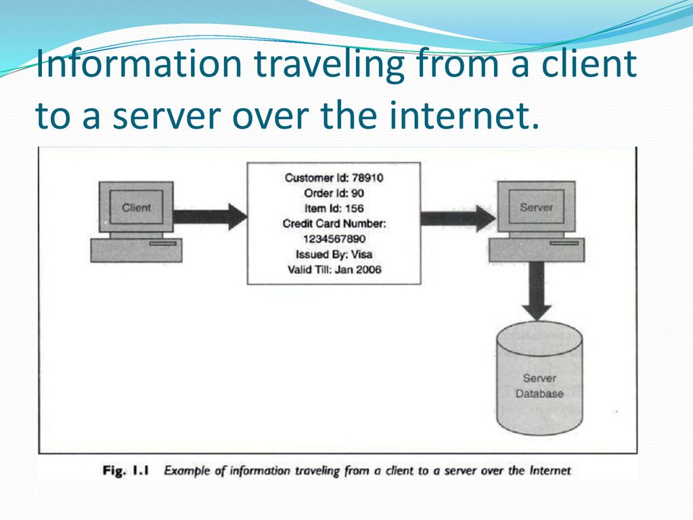
Why we need cryptography:cryptography is used to provide security from different kinds of attack.

Slide 3
Cryptography
characterize cryptographic system by:
type of encryption operations used
substitution / transposition
number of keys used
single-key or private / two-key or public
way in which plaintext is processed
block / stream
Notes:
Cryptographic systems can be characterized along these three independent dimensions.

Slide 4
Principal of security
Confideniality
Authentication
Integrity
Non-repudation
Access control
Availability

Slide 5
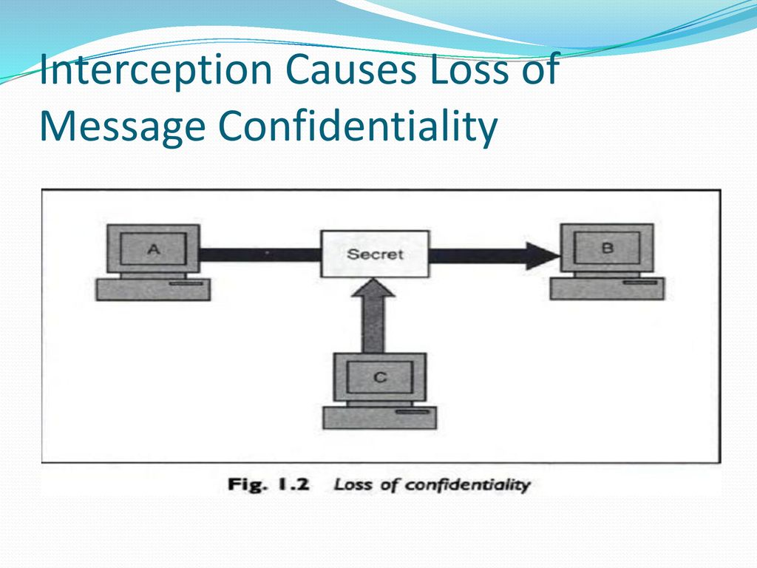
Confidentiality:only the sender and intended recipient should be able to access the contenet of message.

Slide 6
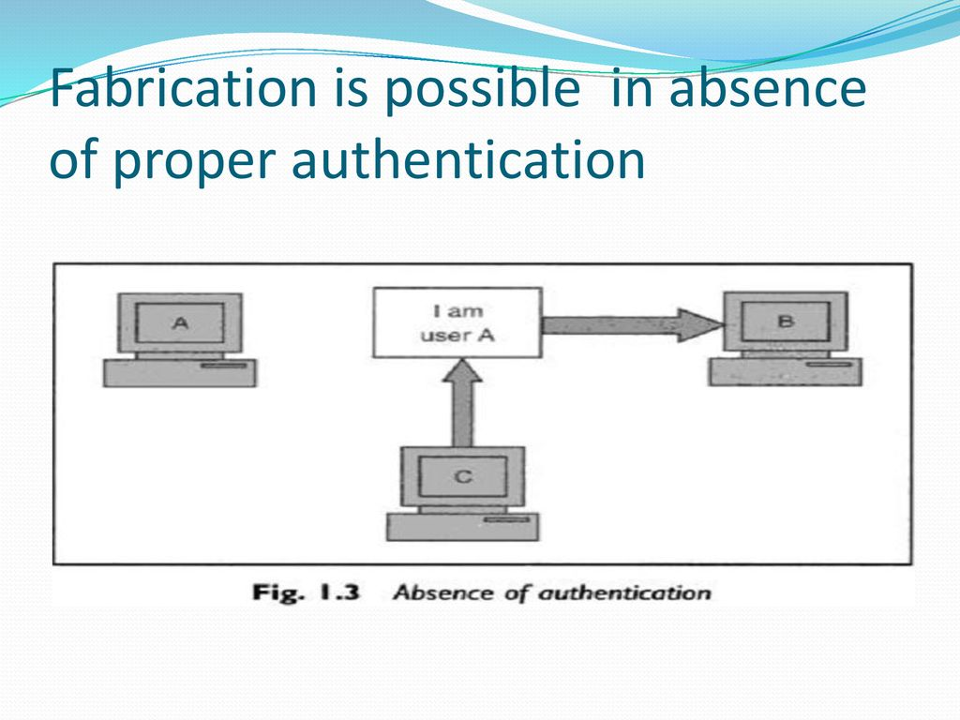
Authentication: help in establishing proof of identities.It ensure that the origin of electronic message is corrhelpectly idetified

Slide 7
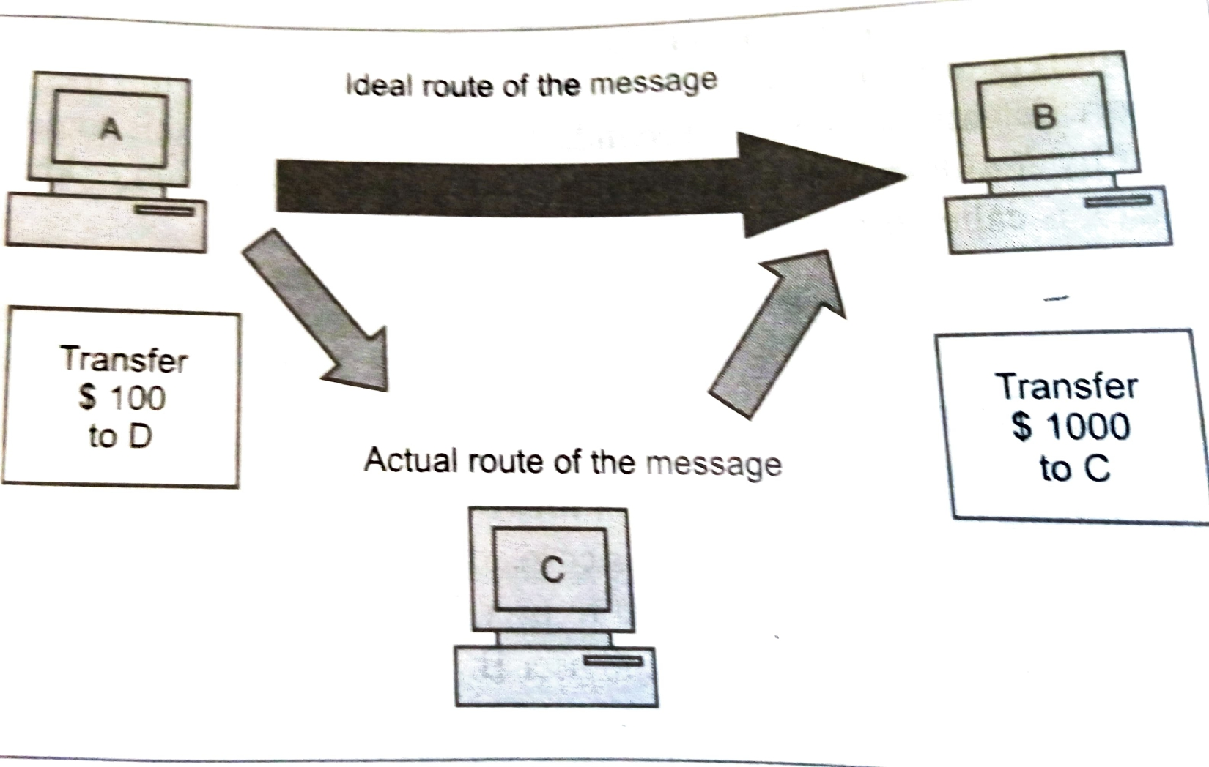
Integrity:the contents of the message should not be change after the sender send it.
Loss of integrity is called modification

Slide 8
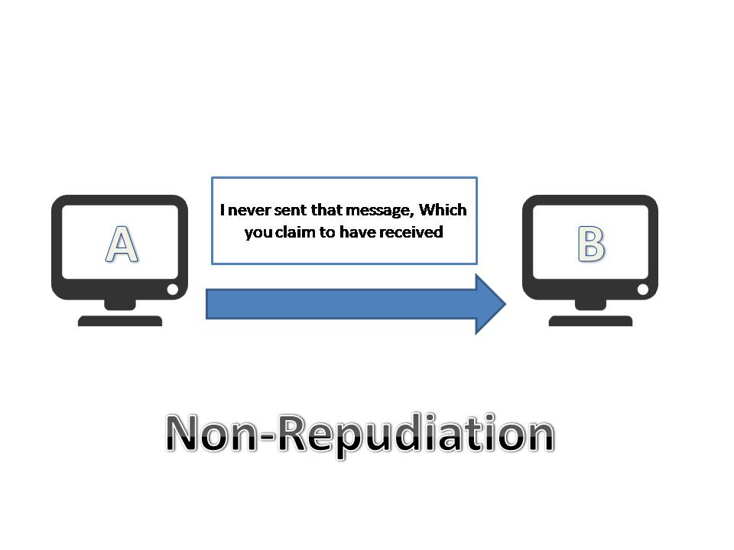
Non repudation:does not allow the sender of a message to refute the claim of not sending that message.

Slide 9
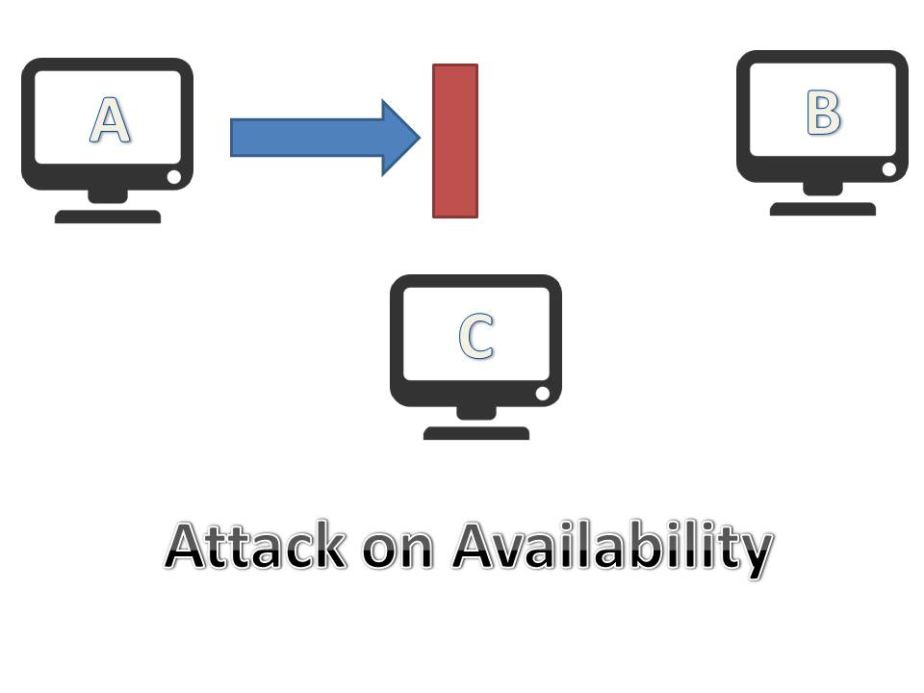
Availability:resources should be available to authorized parties at all the time.

Slide 10
Access control:
Access control specifies and controls who can access what.
For eg.
User A can write can write to file x ,but can only update files y and Z.

Slide 11
Types of Attack
Active attack:the contents of original message are modified in some way.
passive attack:attacker aim is to obtain information that is in transit.the attacker does not attempt to perform any modification to data.

Slide 12
Active attack
Masquerades (absence of authentication)
Modification(loss of integrity)
replay attack
alteration
Denial of service

Slide 13
Passive attack
Release of message content
Traffic analysis

Slide 14
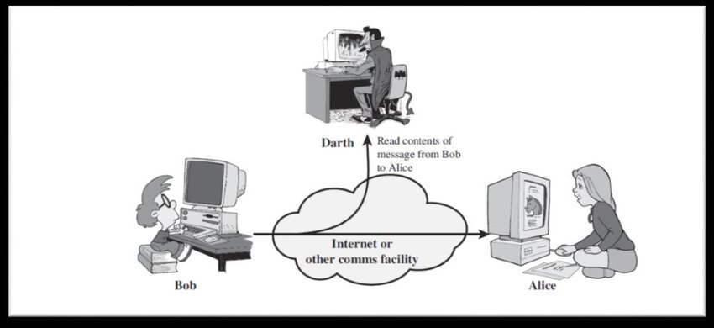
Releaseof message content

Slide 15
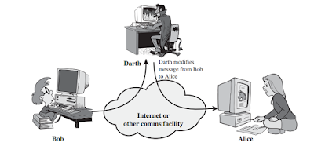
Traffic analysis

Slide 16
privacy
Assures that individuals control or influence what information related to them may be collected and stored and by whom and to whom that information may be dislosed.

